Slide 1


Accenture Innovation Challenge
Harness Generative AI to develop innovative solutions that boost business and societal growth

Slide 2
Instructions Reference slide– Remove before submission
Use the given template for your idea submission.
Follow file naming format: Team name_Idea Name.pptx
Ensure the spell check is done before submitting
Use standard Arial font, alignment and relevant images (as required)

Slide 3

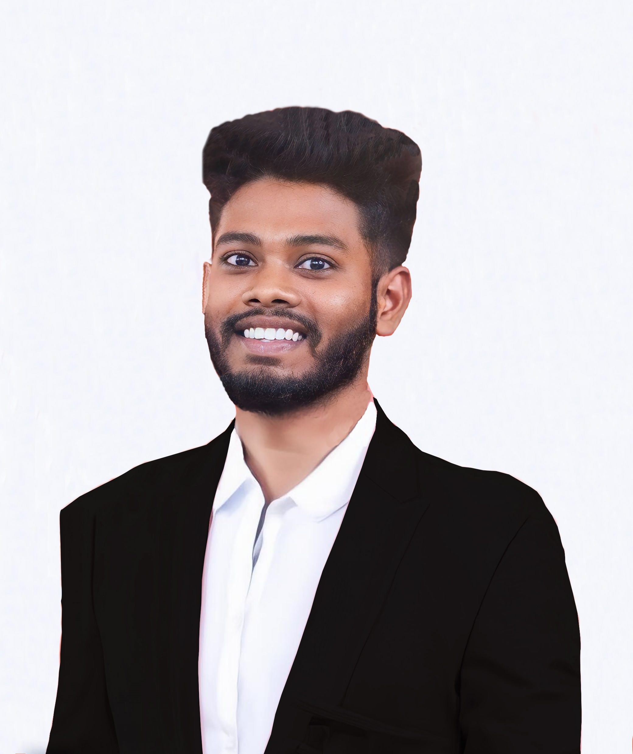
Team details
TEAM NAME: Neural Ninjas
Y.Tarun
I.Dileep Kumar
College: Gayatri Vidya Parishad College Of Engineering
Stream: CSE
Year of graduation: 2025
College: Gayatri Vidya Parishad College Of Engineering
Stream: CSE
Year of graduation: 2025
All fields are mandatory

Slide 4
Describe the problem statement (200 words)
The fashion industry faces several pressing challenges, including overproduction, high environmental impact, and a lack of personalized, sustainable options for consumers. Fast fashion, which prioritizes low-cost, mass-produced clothing, contributes significantly to environmental degradation, including waste, water consumption, and carbon emissions. Additionally, traditional production methods often result in unsold inventory, which either ends up in landfills or requires additional resources to manage.
Consumers, particularly the growing base of eco-conscious individuals, are increasingly demanding sustainable fashion choices and personalized designs that align with their values. However, existing fashion brands often struggle to balance sustainability with affordability and customization. Moreover, customers find it difficult to visualize how clothing will look and fit before making a purchase, leading to high return rates.
This gap between consumer expectations and industry practices points to a need for an innovative solution that combines sustainability with personalization, while minimizing waste. There is an opportunity to use emerging technologies, such as generative AI, AR/VR, and sustainable production techniques, to transform how clothing is designed, produced, and sold. A virtual fashion design platform could address these problems by offering personalized, eco-friendly clothing options, and virtual try-on experiences, leading to a more sustainable, customer-centric fashion industry.

Slide 5
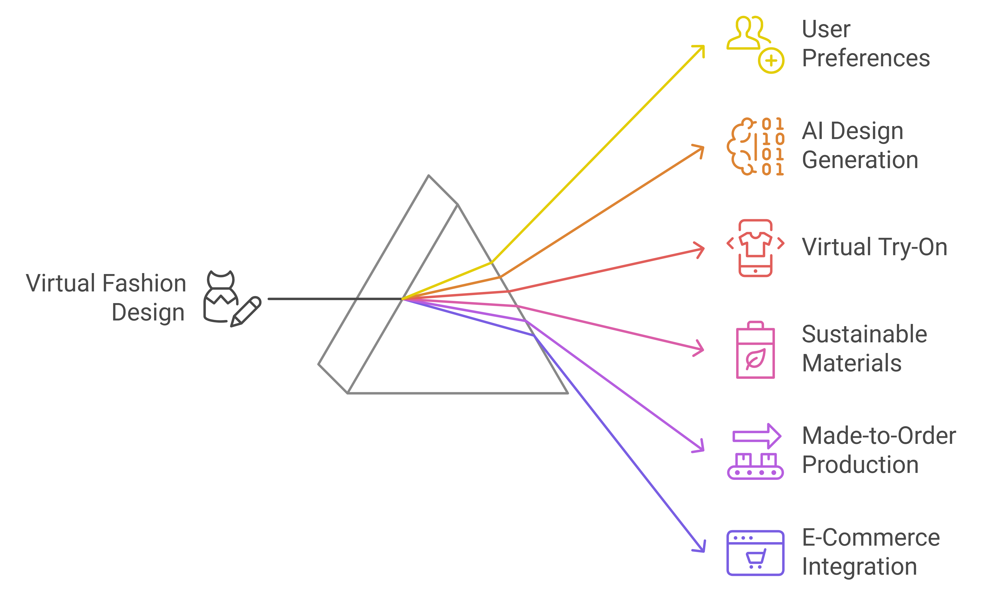
Proposed solution / your big Idea (200 words)
Personalized, eco-friendly clothing designs created based on user preferences (style, body measurements, materials).
Virtual Fashion Design Platform powered by Generative AI, AR/VR, and sustainable production methods.
Generative AI engine customizes designs to match individual tastes and body types.
Virtual Try-On Experience using Augmented Reality (AR) or Virtual Reality (VR) for users to visualize fit and appearance before purchasing.
Sustainability Focus: The platform suggests eco-friendly materials like organic cotton or recycled fabrics.
Made-to-Order Production model, reducing overproduction and minimizing waste.
Disrupts Traditional Fashion: Shifts away from mass production by offering personalized, on-demand fashion.
Enhanced Customer Experience: Combines personalization, sustainability, and immersive technology to provide a unique fashion journey.
Reduces Environmental Impact: Less waste, lower carbon footprint, and promotion
of responsible consumption.
Describe TECHNOLOGY USED: Generative AI (GANs/VAEs), Augmented Reality (AR) and Virtual Reality (VR),
Machine Learning (ML), Computer Vision

Slide 6
How does your innovation accelerate change with the power of Technology? (200 words)
Generative AI: Creates personalized, unique clothing designs based on user preferences, body types,
and style inspirations.
Empowers consumers to become co-creators in the fashion design process.
Tailors designs for each individual, reducing waste from ill-fitting or unwanted garments.
Augmented Reality (AR) and Virtual Reality (VR): Enhances customer experience through virtual try-ons.
Allows consumers to visualize how clothing will look and fit without physical garments.
Drastically reduces return rates and waste from unsold inventory.
Sustainable Material Integration: Recommends eco-friendly materials and promotes
made-to-order production.
Minimizes overproduction and reduces environmental harm.
Addresses sustainability challenges within the fashion industry.
Accelerates Change:
Promotes sustainable fashion and reduces waste.
Empowers customers with personalization while making the fashion industry more environmentally conscious.
Enhances consumer engagement through the use of cutting-edge technologies like AR/VR.

Slide 7
How is your solution different/unique from other solutions in market? (150 words)
Our Virtual Fashion Design Platform is unique because it integrates Generative AI, AR/VR, and sustainable practices in one seamless experience, unlike traditional fashion platforms. While other solutions may offer customization or virtual try-ons, this platform stands out by combining:
AI-Powered Customization: The use of Generative AI creates fully personalized designs based on user preferences and body measurements, offering a deeper level of customization than what is typically available.
Sustainability Focus: The platform actively promotes eco-friendly materials and made-to-order production, minimizing waste and supporting sustainable fashion practices.
Virtual Try-On via AR/VR: The virtual try-on feature allows customers to see how clothes fit in real-time using AR/VR technology, reducing returns and improving customer satisfaction.
This combination of personalization, sustainability, and immersive shopping makes the platform distinct, providing a holistic solution to the growing demand for sustainable and customer-focused fashion experiences.
PATENT FILED: No
Do you have a working model/prototype: Yes/No
If not, will you be able to show working prototype during finale. Yes/No

Slide 8
Any testimonials received?
Share the links/photos of the testimonials you’ve received

Slide 9
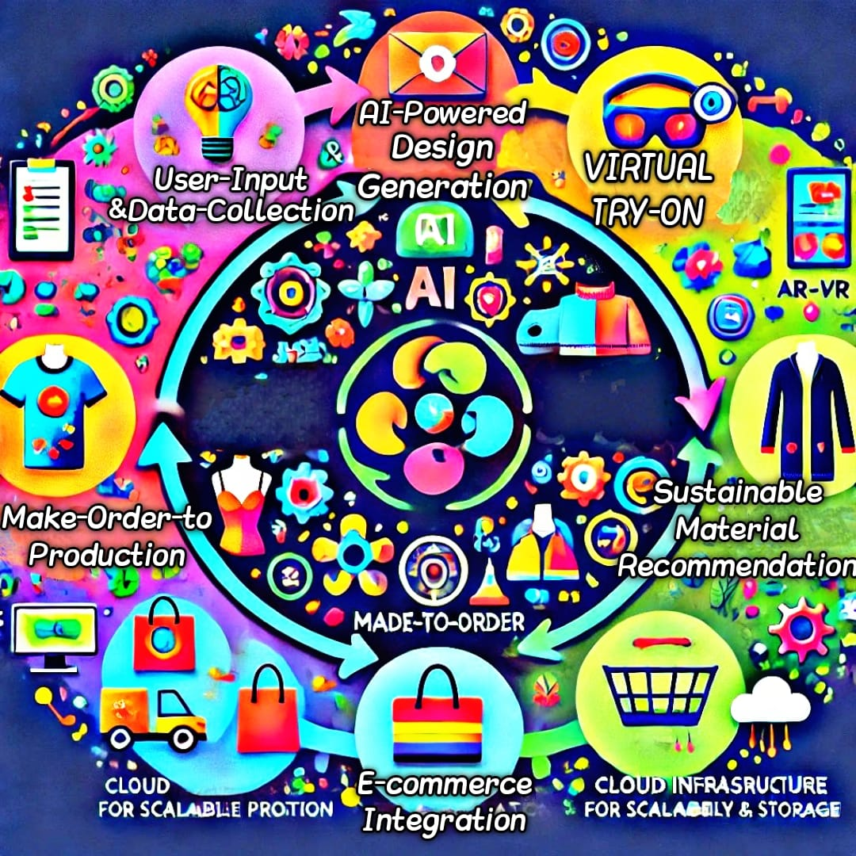
Please share a 1-minute video of your idea (embed on this PPT or add a downloadable link)

Slide 10
Thank you!

